Slide 1


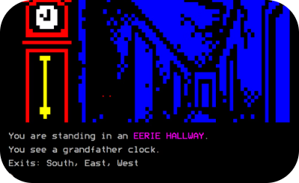

Introduction to Adventure Text Games in Python
Captivating Code
Immersive Storytelling
Imagination Unleashed
Unleash the power of Python to bring intricate narratives to life through the art of coding.
Dive into captivating tales where your choices shape the outcome, creating a truly immersive experience.
Let your creativity soar as you craft vibrant, text-based worlds that transport players to new realms.

Slide 2



Setting up the Development Environment
Install Python
1
Download and install the latest version of Python on your computer.
Choose an IDE
2
Select a powerful Integrated Development Environment (IDE) like PyCharm, Visual Studio Code, or Spyder.
Set Up Version Control
3
Use a version control system like Git to track changes and collaborate with others.
To get started with creating your own adventure text game in Python, you'll first need to set up your development environment. This includes installing the Python programming language, choosing a powerful IDE to write your code in, and setting up version control to manage your project files. With these foundational pieces in place, you'll be ready to dive into the exciting world of interactive storytelling.

Slide 3
Understanding the Basics of Python Syntax
1
Python Indentation
2
Variable Naming Conventions
Python uses whitespace indentation to define code blocks, unlike curly braces in languages like Java or C++. Proper indentation is crucial for the code to execute correctly.
Python follows the snake_case naming convention for variables, where words are separated by underscores. This helps improve code readability and maintainability.
3
Data Types and Operators
4
Control Flow Statements
Python supports various data types, including integers, floats, strings, and booleans. Arithmetic, comparison, and logical operators can be used to perform operations on these data types.
Python's control flow statements, such as if-else, while, and for loops, allow you to write conditional logic and iterate over data structures.

Slide 4
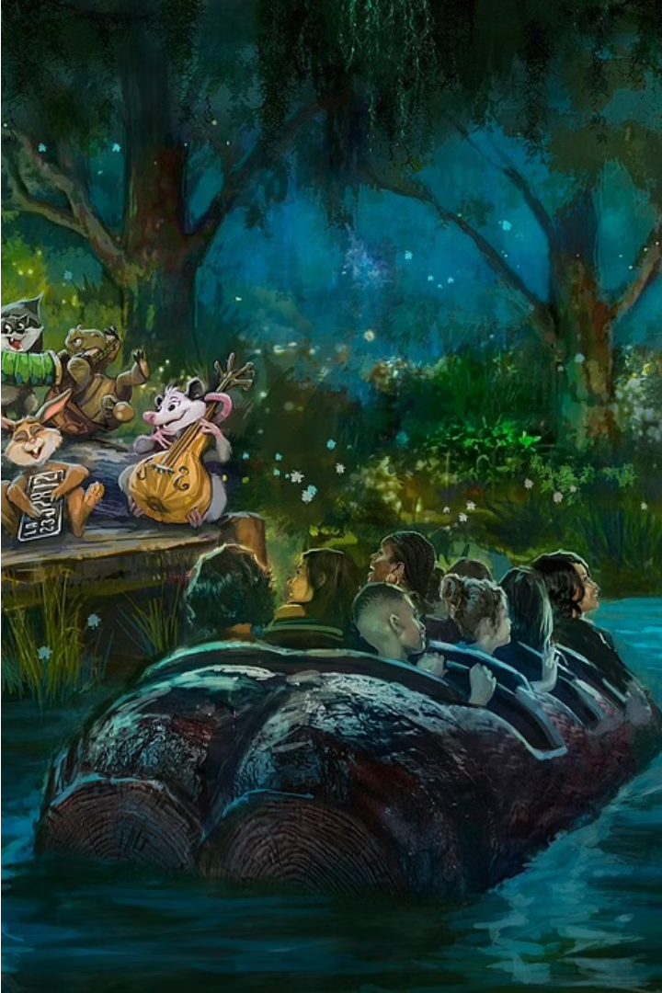
Defining the Game Narrative and Storyline
Crafting an engaging and immersive adventure game narrative is crucial to captivating players. Begin by envisioning a compelling world, relatable characters, and a thought-provoking central conflict. Weave in dramatic twists, moral dilemmas, and surprising discoveries to keep players invested in the unfolding story.
Establish clear objectives, obstacles, and turning points that drive the player forward on an exciting journey of exploration and decision-making. Leverage branching storylines and multiple endings to empower players and encourage replayability.

Slide 5
Implementing Conditional Statements (if, else, elif)
Understanding If-Else Statements
Using Elif for Multiple Conditions
Nesting Conditional Statements
Optimizing Conditional Logic
Conditional statements in Python, such as if-else, allow you to make decisions based on specific conditions. The if statement checks if a condition is true, and the else statement executes if the condition is false.
The elif (else if) statement enables you to check for additional conditions when the initial if statement is false. This allows for more complex decision-making in your adventure game.
You can also nest conditional statements within each other, creating a hierarchy of decisions. This enables you to build intricate branching scenarios in your text-based adventure game.
As your game grows in complexity, it's important to optimize your conditional statements to ensure efficient and logical decision-making for the player. Thoughtful structuring can enhance the overall gameplay experience.

Slide 6
Accepting User Inputs and Handling Responses
Prompt the User
1
Ask the player for their next move or decision.
Validate Input
2
Ensure the user's response is valid and aligns with the game's choices.
Process the Response
3
Determine the outcome based on the player's input and the game logic.
Creating an engaging adventure text game requires seamlessly integrating user input and handling responses. Start by prompting the player for their next action, then validate the input to ensure it's within the game's scope. Finally, process the response and update the game state accordingly, guiding the player through the story.

Slide 7

Incorporating Branching Paths and Decision-Making
Develop a branching narrative structure that allows players to make meaningful choices that impact the story's progression and outcome. This creates a sense of agency and replayability.
Ensure that player choices have tangible consequences, whether positive or negative. This encourages careful consideration and strategic thinking, as players weigh the potential outcomes of their actions.
Craft multiple potential endings based on the player's decisions throughout the game. This introduces a sense of unpredictability and replayability, as players are motivated to explore different paths to uncover all possible conclusions.

Slide 8
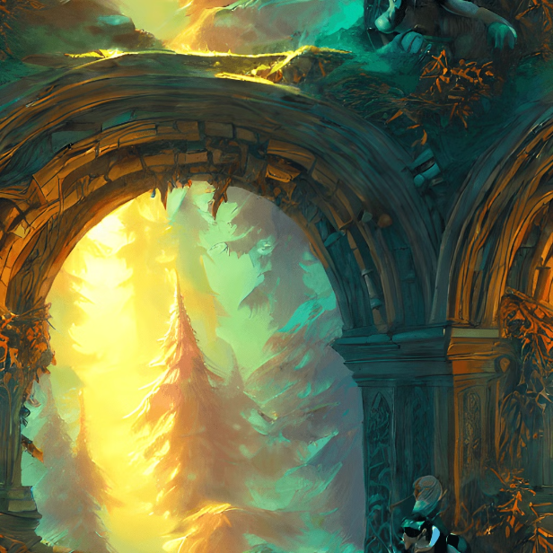
Adding Descriptive Text and Feedback to the Player
As the player navigates your adventure text game, providing rich, descriptive text is crucial to immersing them in the world. Craft vivid descriptions of the environments, characters, and events unfolding, allowing the player to visualize the scene in their mind.
Offer clear, meaningful feedback to the player's actions, whether it's congratulating them on a successful decision or gently guiding them when they encounter obstacles. This feedback helps the player understand the consequences of their choices and encourages them to keep exploring.

Slide 9

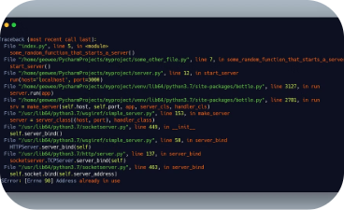
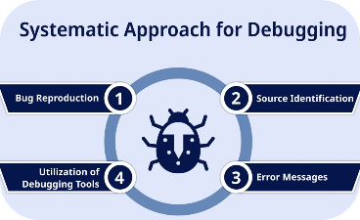
Debugging and Troubleshooting Common Issues
Utilize Debugging Tools
Understand Error Messages
Employ a Systematic Approach
Python offers powerful debugging tools like the built-in debugger and third-party libraries like pdb and pudb. Leveraging these tools can help you identify and resolve issues in your code efficiently.
Python provides clear and informative error messages that can guide you towards the root cause of the issue. Learn to decipher these messages and use them to your advantage during the debugging process.
Develop a methodical debugging process that involves steps like isolating the problem, using print statements, and systematically testing your code. This structured approach can help you identify and fix issues more effectively.

Slide 10
Sharing and Distributing Your Adventure Text Game
Showcase Your Creation
1
Once you've polished your adventure text game, it's time to share it with the world. Consider posting it on online platforms like GitHub, itch.io, or your personal website to showcase your programming skills and creativity.
2
Seek Feedback and Collaboration
Connect with online communities of interactive fiction and text-based game enthusiasts. Engage with them, gather feedback, and even explore opportunities for collaboration to further enhance your game.
Monetize and Distribute
3
If you're interested in monetizing your game, explore options like selling it on digital marketplaces or offering it as a free download with optional in-game purchases. Consider distributing your creation through various channels to reach a wider audience.

